Slide 1
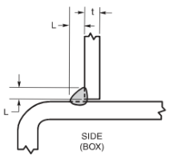
Prequalified Fillet weld

